Slide 1

Architecture Exploration of Standard-Cell and FPGA-Overlay CGRAs Using the Open-Source CGRA-ME Framework
S. Alexander Chin, Kuang Ping Niu, Matthew Walker, Shizhang Lin, Alexander Mertens, Jongeun Lee, Jason H. Anderson
ACM ISPD, Seaside, CA
March 26, 2018

Slide 2
What are Coarse-Grained Reconfigurable Arrays (CGRAs)?
A style of programmable logic device between an ASIC and an FPGA on the programmability spectrum
Large coarse-grained blocks, datapath interconnect
Blocks may be entire ALUs
Interconnect 16/32-bit wide
Tailor CGRA block functionality to application domain:
DSP
Machine learning
Finance
…

Slide 3
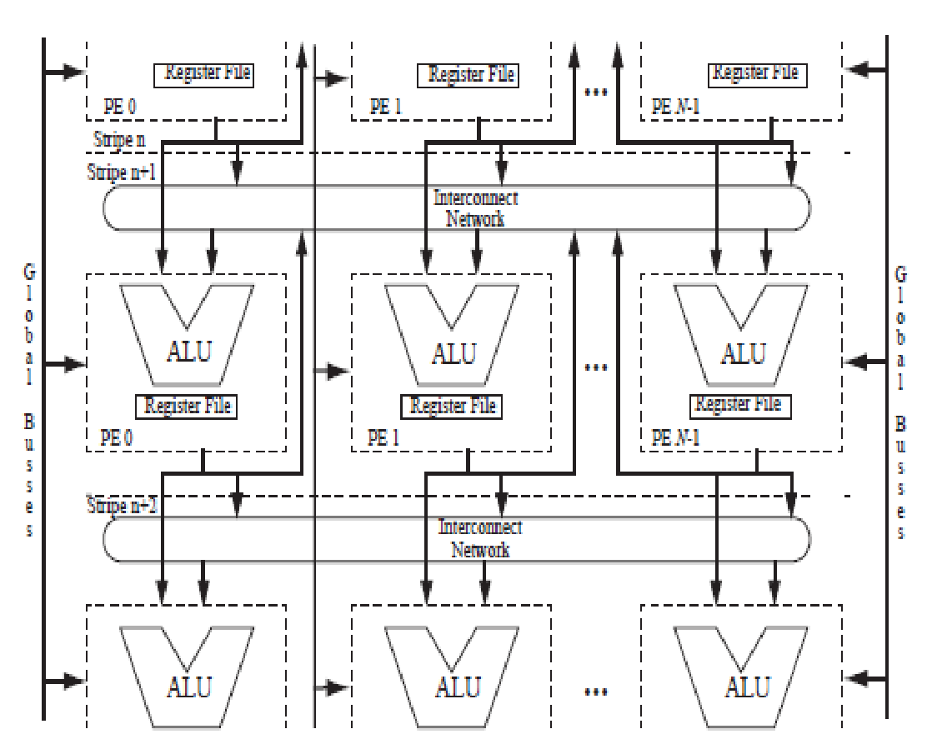
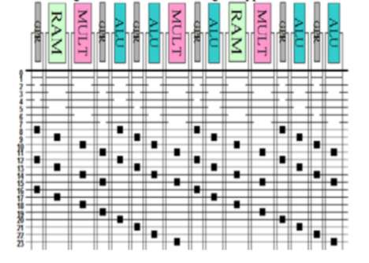
Example CGRA Architectures (1)
RaPiD / Totem Project
PipeRench

Slide 4
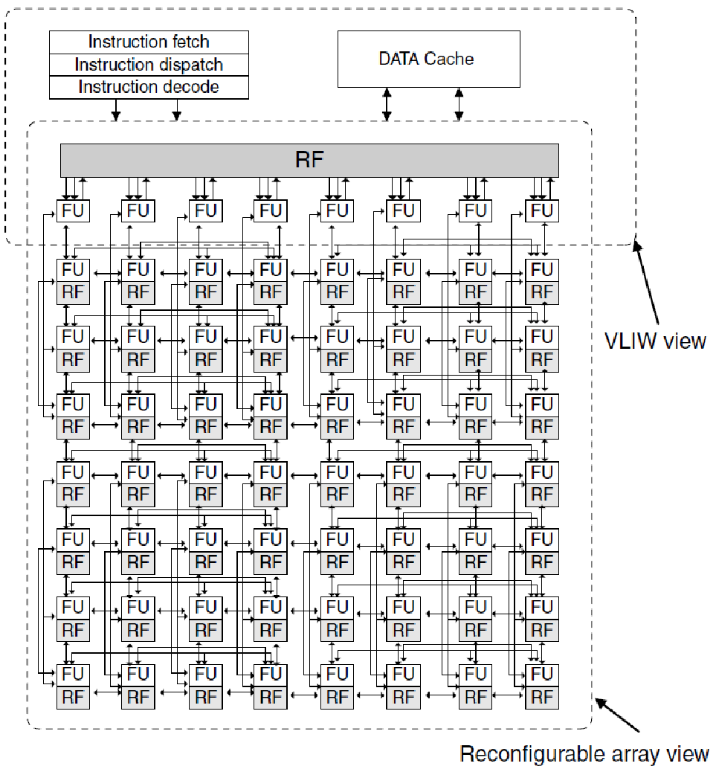
Example CGRA Architectures (2)
ADRES

Slide 5
Multiple Contexts
FPGAs have a static configuration: configure then use
Some CGRAs are “multi-context”:
Multiple configurations are stored in the CGRA
Each configuration is called a context
Rotate through configurations on a cycle-by-cycle basis
Logic functionality and routing paths change
X
/
Context 1
Context 0
>>
+
AND
OR

Slide 6
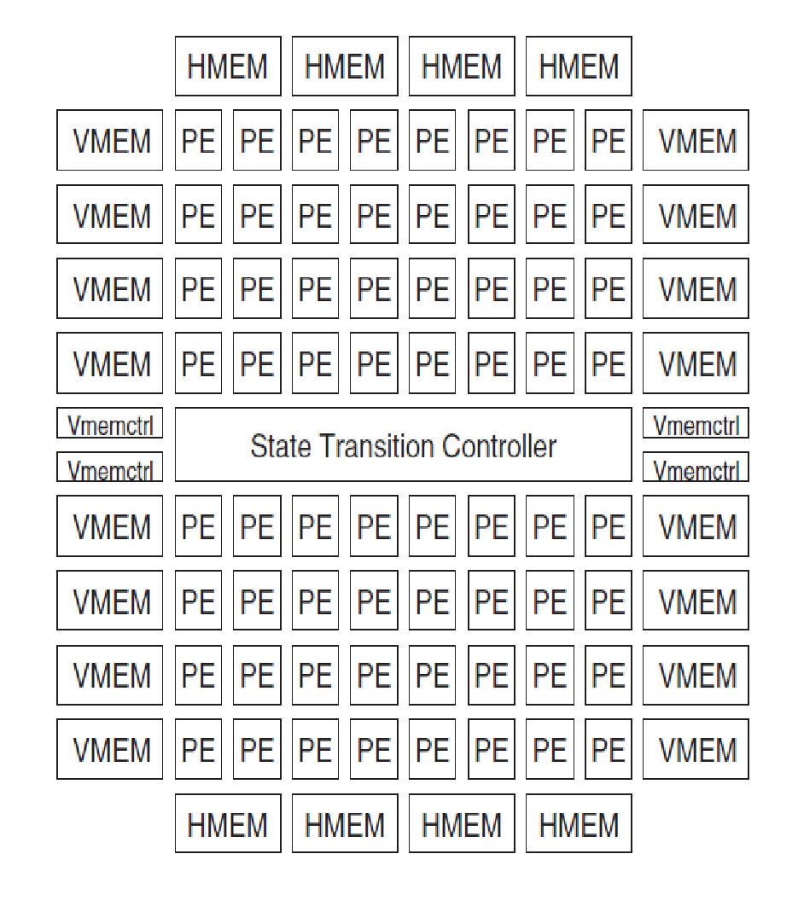
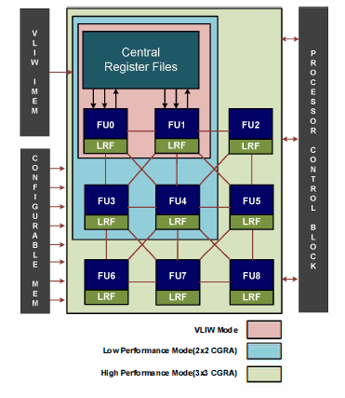
Example CGRA Architectures (3)
DRP (Renesas / NEC)
SRP (Samsung)

Slide 7
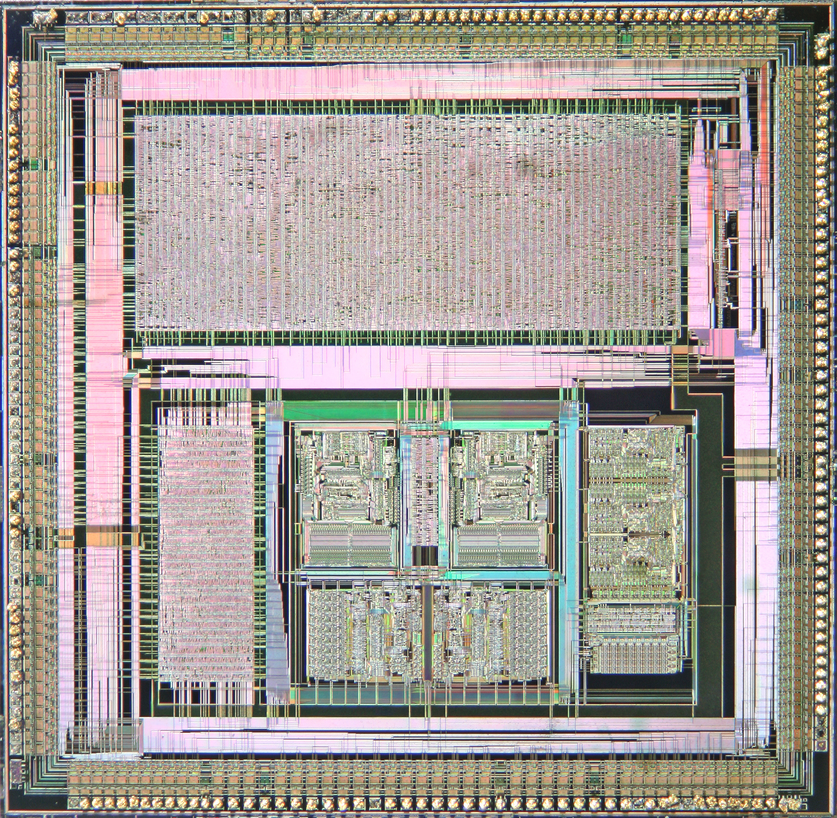
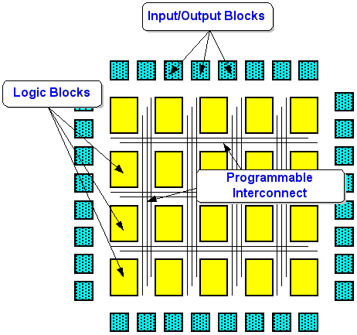
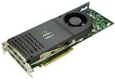

Efficiency vs. Programmability
Custom ASIC
Efficiency
CGRA
Must “stitch together” many LUTs, interconnect segments to implement functionality on FPGA
FPGA
GPGPU
General Purpose
Processor
Typical application:
FPGA 300 MHz, 10 W
ASIC 1.2 GHz, 2.5 W
CGRA 1 GHz, 3 W
Large coarse-grained blocks aligned to application, bus-based routing
Programmability
Notes:
highlight the different types of CGRAs
commonality is that dataflow is paramount
efficiency stems from spatial computing at the instruction level
*** For domain specific computing
TODO: GPGPU picture, CPU picture

Slide 8
Efficiency vs. Programmability
Custom ASIC
CGRA
Efficiency
FPGA
GPGPU
General Purpose
Processor
FPGA Overlay
Programmability
Notes:
highlight the different types of CGRAs
commonality is that dataflow is paramount
efficiency stems from spatial computing at the instruction level
*** For domain specific computing
TODO: GPGPU picture, CPU picture

Slide 9
FPGA Overlays
Overlays are a layer of abstraction on top of FPGAs
Pre-compiled architectures that are further programmable
e.g. soft-processors, stream processors, coarse-grained reconfigurable arrays – FPGA Overlay CGRA
Benefits of overlays:
Ease of use – compile software to configure the overlay
Can be optimized towards specific application domains

Slide 10

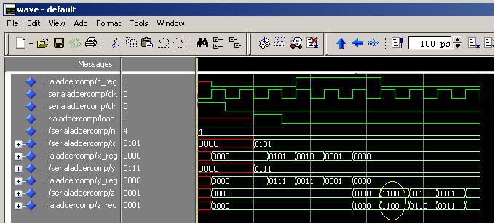
Overlays / FPGA Ease-of-Use
Two main challenges with FPGA ease-of-use:
1) Require HW design expertise
2) Lengthy compile times: hours/days
HLS addresses #1
Overlays aim to address both

Slide 11





Vision: Overlays / FPGAs in the Cloud
computational
finance
Library of pre-compiled cloud-deployed FPGA-Overlay CGRA accelerators
Application to accelerate
Envision a library of FPGA accelerator overlays in cloud
Choose the overlay that best meets application’s needs
Map software application onto overlay accelerator

Slide 12
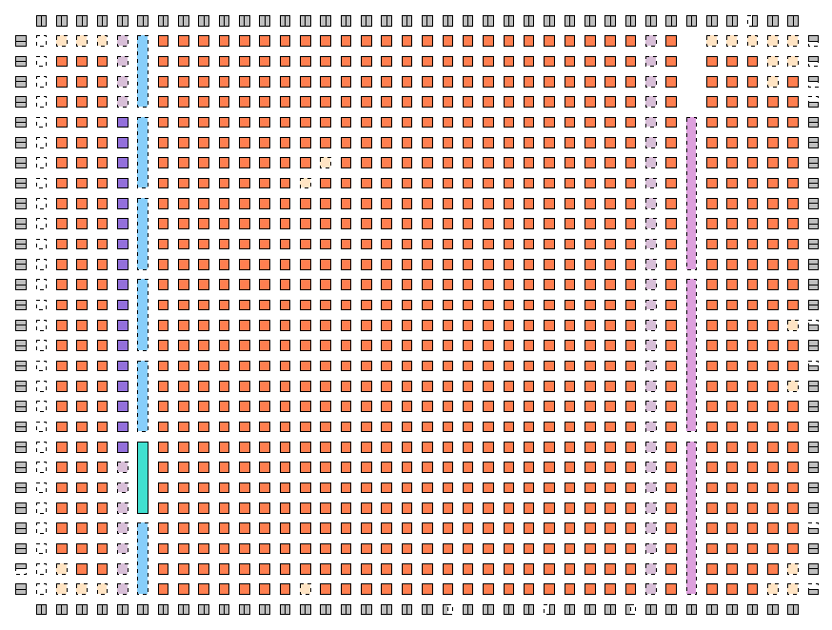
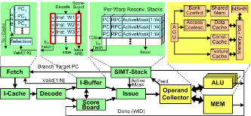
CGRA Challenges
Architectures less studied than competition, such as FPGAs or GPGPUs
CAD tool development required
CGRAs: ???
FPGAs:
Verilog-to-Routing
GPUs:
GPGPU-Sim
Notes:
- why cgra

Slide 13
Introduction to CGRA-ME
CGRA-ME is an open-source modelling and exploration framework for CGRA architecture and CAD exploration
Project objectives:
Allow an architect to model a wide range of CGRA architectures through an XML-based language
Allow an application, described in a high-level language, to be mapped onto the modelled CGRA
Simulation and verification of application on modelled CGRA
Physical realization of the CGRA as an ASIC or FPGA overlay
High-level area, performance, and power modelling of the CGRA for an application

Slide 14
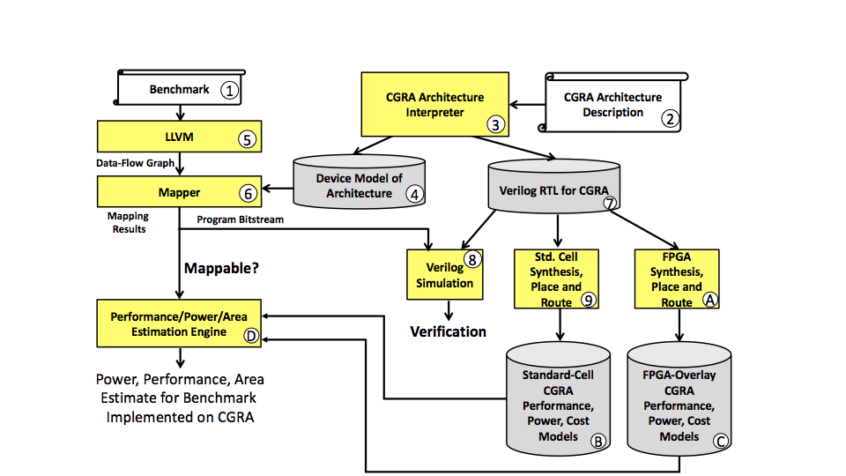
CGRA-ME: Framework Overview
Notes:
Xander starts here

Slide 15
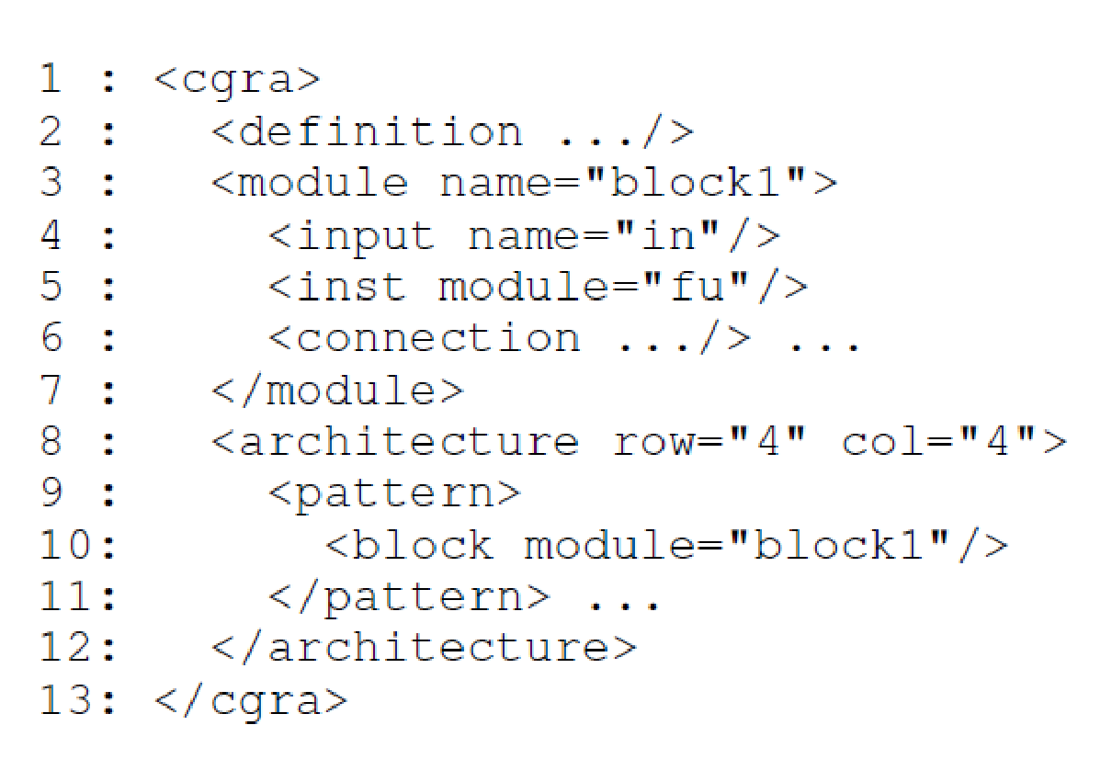
CGRA-ADL (1)
XML-based description language for architects
Describe CGRA blocks, their layout and hierarchy
Describe interconnect within the CGRA
I/O
I/O
…
I/O
B0
B1
I/O
B(X)
B(X+1)
…

Slide 16
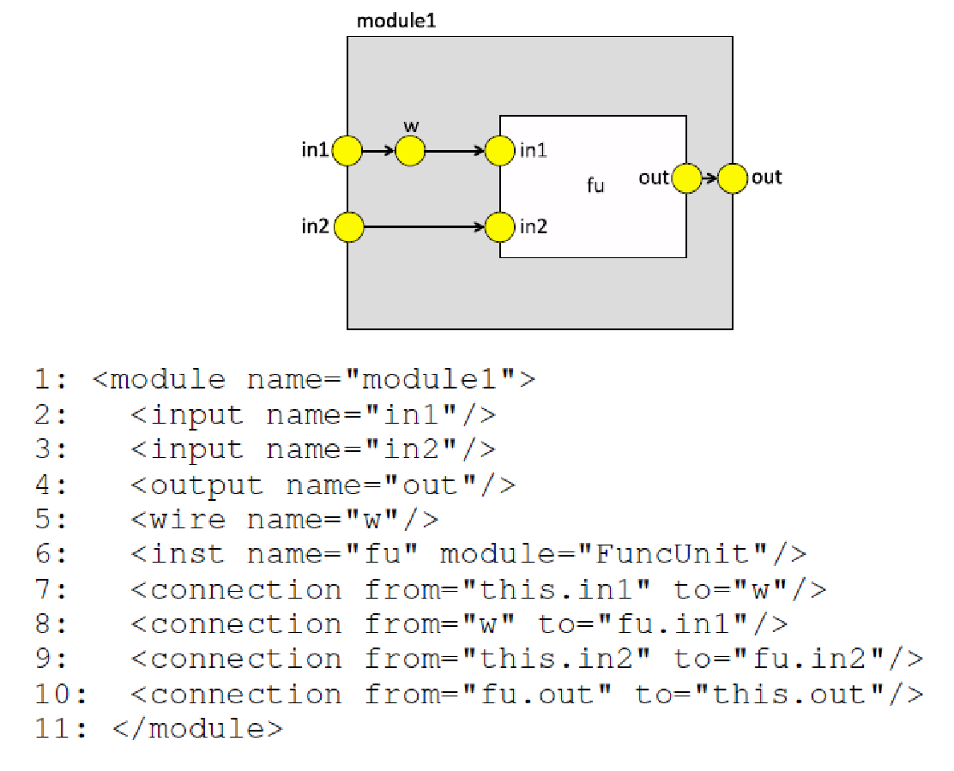
CGRA-ADL (2)

Slide 17
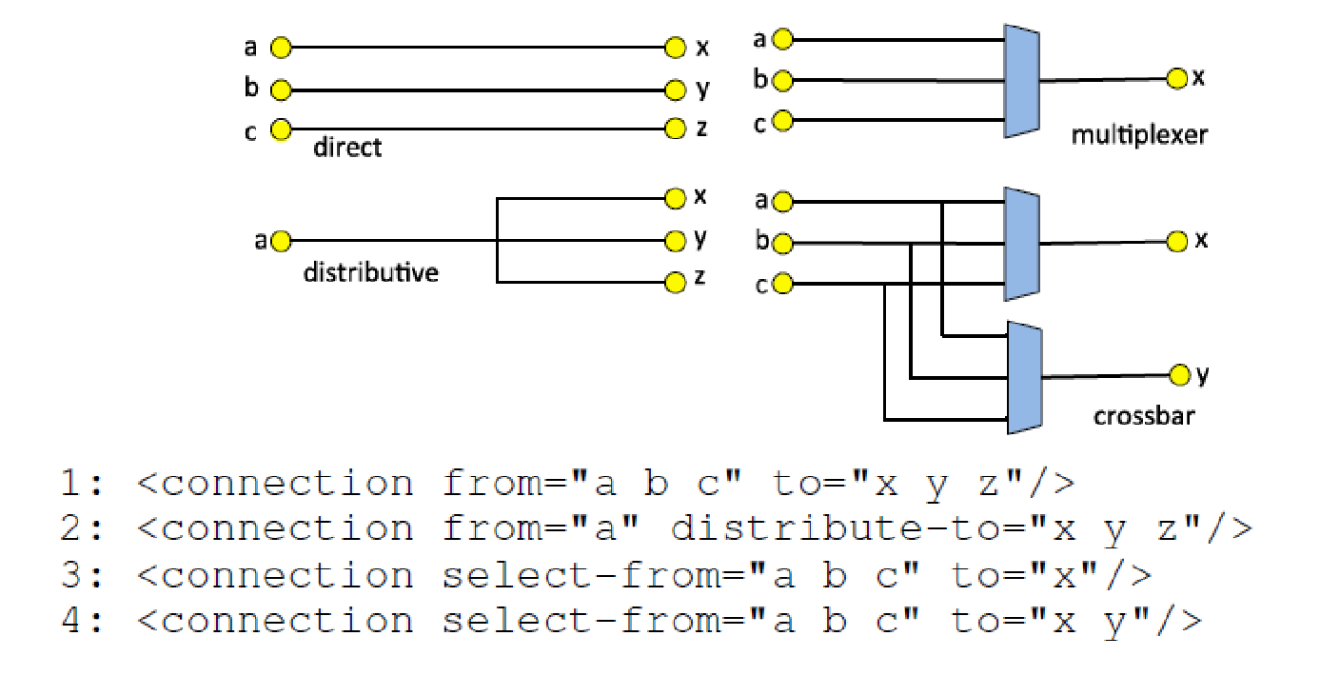
CGRA-ADL (3)

Slide 18
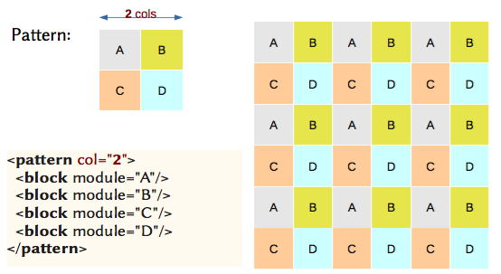
CGRA-ADL (4)
Language has constructs to model CGRA at top-level
Homogeneous or heterogeneous

Slide 19
CGRA-ME: Framework Overview
Notes:
Xander starts here

Slide 20
Mapping Applications to a CGRA
Front-end data-flow graph extraction - LLVM
State-of-the-art compiler used by Apple, NVIDIA, Xilinx, Intel, etc
Leverage LLVM language support, parsing and optimizations
In LLVM, the program is represented in an Intermediate Representation (IR)
Machine-independent assembly code
Limited instruction set: add, xor, branch, mul, div
Target inner-loop kernels for mapping to CGRAs

Slide 21
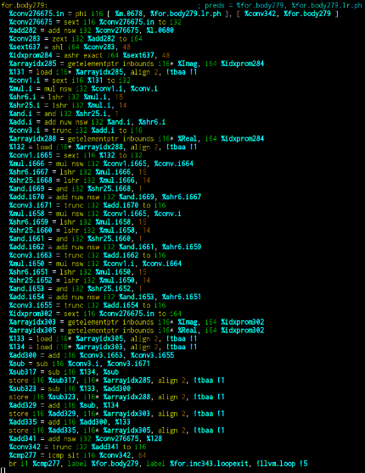
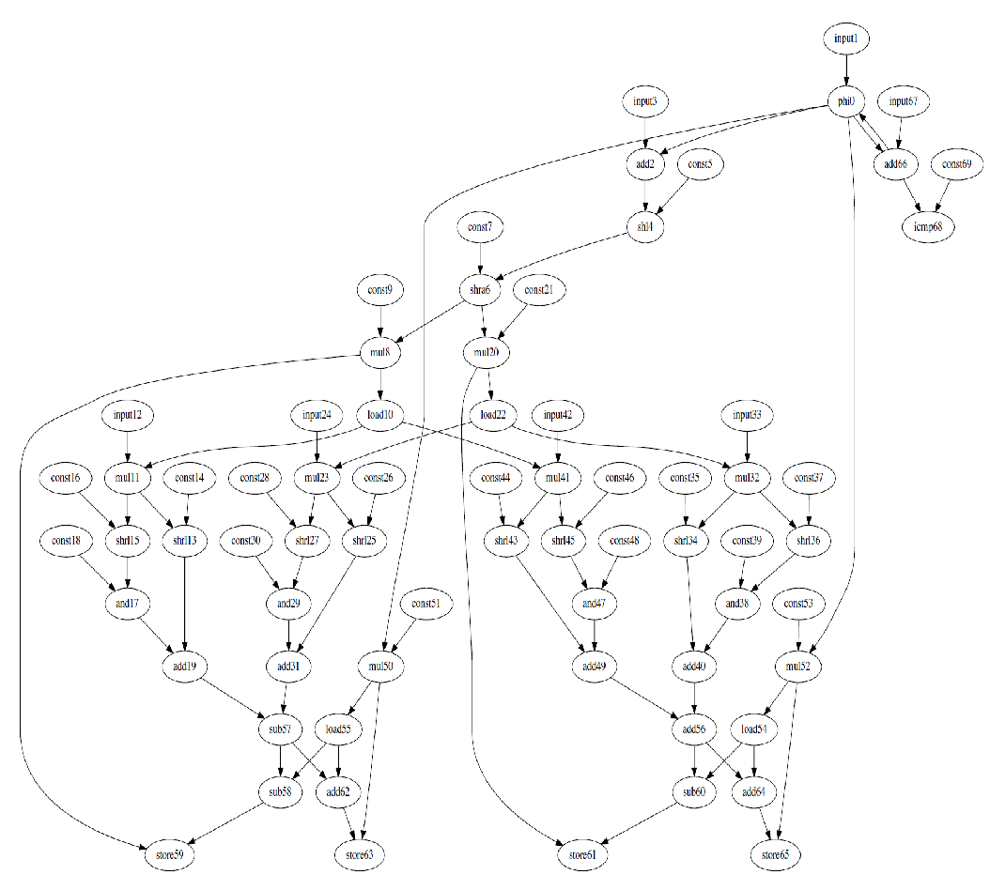
Data-Flow Graph Extraction
FFT IR code in LLVM

Slide 22
LLVM IR-based CGRA Functional Units
We align the functionality specification of CGRA blocks with the LLVM IR computational instructions
The capabilities of the architecture are expressed in the same instruction set as the compiler to the architecture
Example Block
mul | add | mul->add
FU
REG

Slide 23
CGRA-ME: Framework Overview
Notes:
Xander starts here

Slide 24
Mapping Background
Three main tasks
Scheduling
determine when to perform an operation
Placement
determine which functional unit should perform an operation
Routing
Ensure a valid route for value between subsequent operations
Modulo Routing Resource Graph

Slide 25
Modulo Routing Resource Graph
Generalizable – handles multiple configuration contexts
Piecemeal construction
Example Block
FU
REG
From previous clock cycle
To next clock cycle

Slide 26
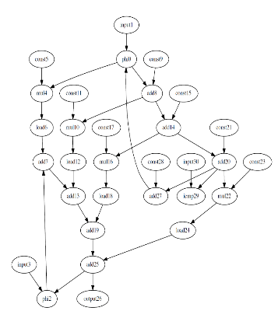
2-context Example
Cycle / Context 0
Cycle / Context 1
Data Flow Graph
Two Mappers:
Simulated annealing
Integer Linear Programming (DAC 2018)

Slide 27
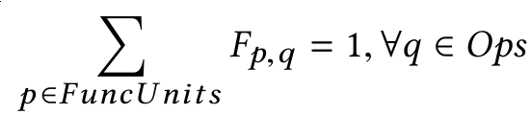
CGRA Mapping Using Integer Linear Programming
Consider mapping problem as a constraint problem - ILP
Formulation “highlights”:
Consider two sets of binary variables
F_{p,q} if 1, Op q is mapped to FU p
R_{i,j} if 1, Val j is mapped to RR i
Every Op must be mapped to a Functional Unit:

Slide 28
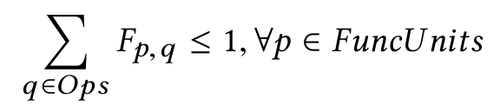
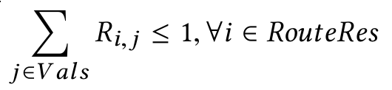
Mapping Algorithm: Integer Linear Programming (cont’d)
At most one Op can be mapped to a Functional Unit
Values cannot use the same routing resource
Additional constraints guarantee that values are routed from Op outputs to Op inputs.

Slide 29
CGRA-ME: Framework Overview
Notes:
Xander starts here

Slide 30
Verilog Generation (1)
Generate RTL for:
Simulation / Verification
Std. cell Synthesis
FPGA-overlay Synthesis

Slide 31
Verilog Generation (2)
CGRA
IO
IO
IO
Take the module tree that the MRRG was generated from, and emit a parameterized Verilog file for each module type:
Includes ports, sub-module declarations, and a generic implementation of the block.
Modules for configuration are also added to the parent module of their configuration target
Automatically connected to the right module, and linked together to form an inter-module scan chain.
FU
FU
FU
FU
FU
FU
FU
FU
FU
io
io
Func. U.
Func. U.
C
C
ALU
ALU
Func. U.
C
C
ALU
ALU

Slide 32
Configuration Bitstream Generation
A successful mapping associates all nodes and edges in the DFG with one or more MRRG nodes.
Iterate the configuration sub-modules, generate a configuration bitstream for the submodule for the application.
+
FU
REG
DFG
MRRG
Modules

Slide 33
Functional Verification
Configuration bitstream is emitted as part of a “configurator” Verilog module
Testbench instantiates configurator & CGRA, provides clock signal, etc.
Permits functional verification of the CGRA as configured for an application
CGRA-ME
Testbench
benchmark.c
Configuration Gen.
configurator.v
ModelSim
Verilog Gen.
CGRA.v

Slide 34
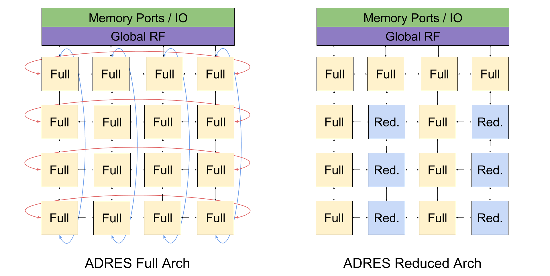
Experimental Study (1)
We compare two variations of 4x4 ADRES:
Homogeneous with torus connections
every PE can do full set of ops (mul, shift, add/sub, logical)
Heterogeneous without torus connections
every other columns’ PEs can do reduced set of ops (add/sub)

Slide 35
Experimental Study (2)
Verilog implementations are generated by the framework, and are synthesized for:
Standard-cell Implementation: FreePDK45 standard-cell library
FPGA-overlay Implementation: Stratix IV
10 benchmarks mapped to both architectures

Slide 36
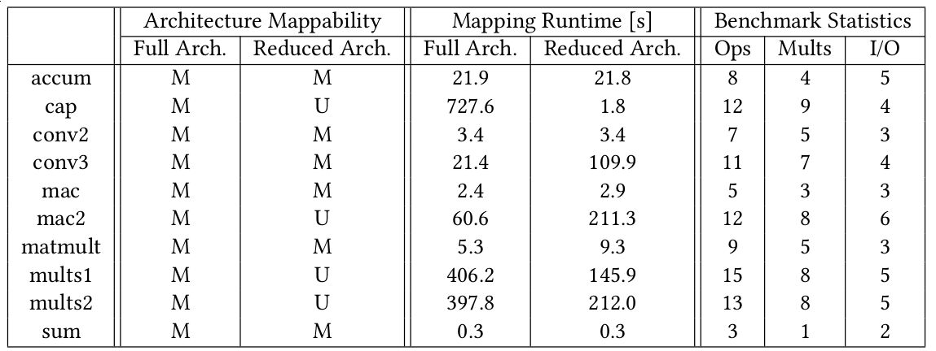
ILP Mapping Results

Slide 37
Standard Cell CGRA
Targeting FreePDK45 standard cell library
Open source 45nm standard cell library
Implementation is not optimal, but allows relative comparisons between architectures
Synthesized with Synopsys Design Compiler
Place and route with Cadence Innovus (floorplanned)
STA performed using Synopsys Prime Time
Two targeted objectives
Minimal delay
Minimal area

Slide 38
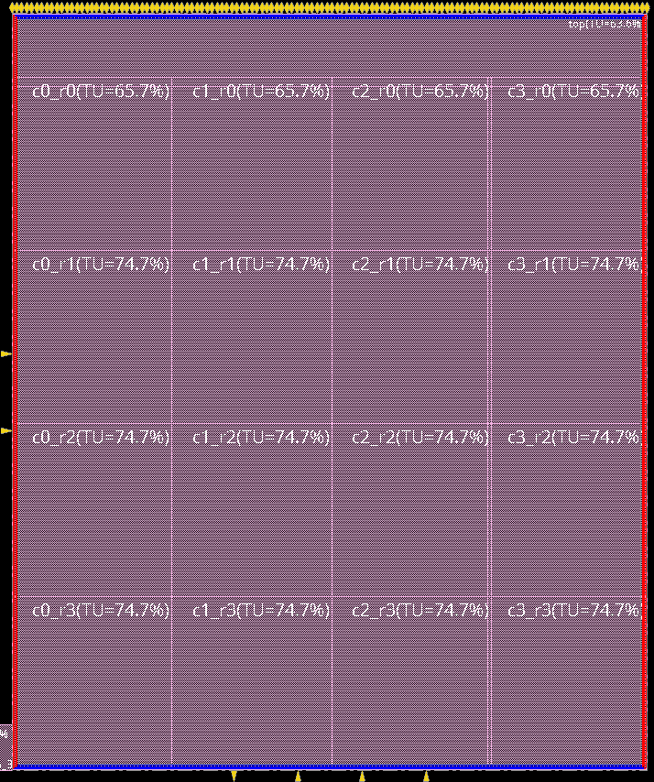
Standard Cell CGRA
Generic floorplan for ADRES-like architectures:

Slide 39
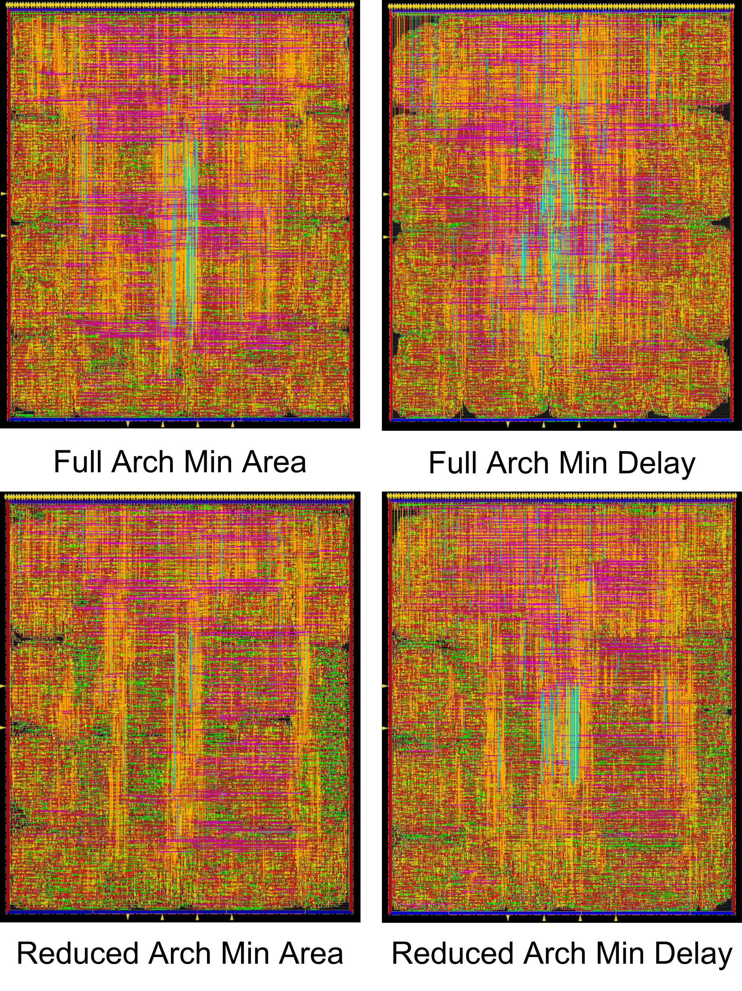
Standard Cell CGRA

Slide 40
Standard Cell CGRA
Comparison between architectures and objectives:

Slide 41
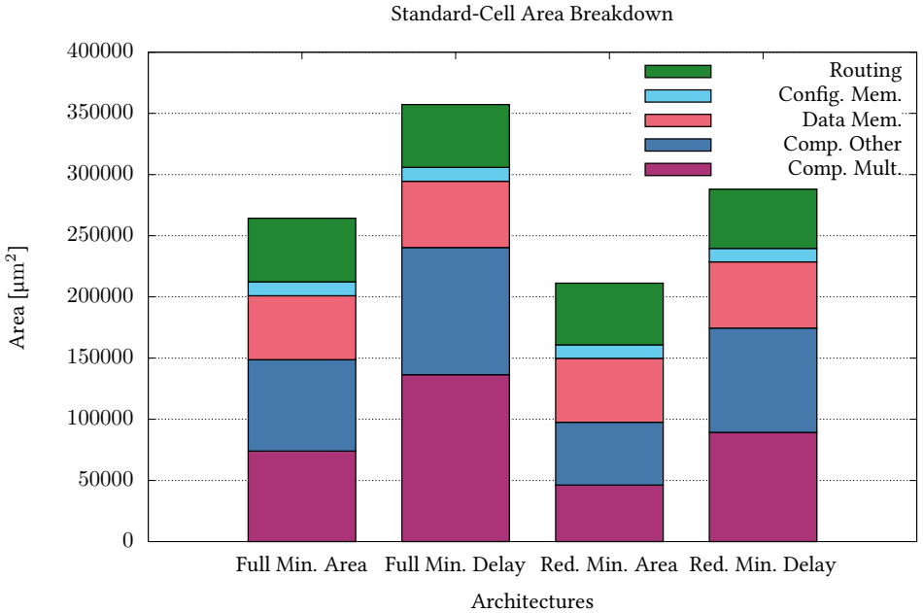
Standard Cell CGRA

Slide 42
FPGA-Overlay CGRA (1)
Implemented same architectures on Stratix IV (45nm Altera/Intel FPGA)
Exactly same CGRA Verilog specification as in the standard-cell case
Floorplanned to ensure physical tile ordering in layout matches with “expected” ordering (e.g. col 2 tiles are to the right of col 1 tiles, etc)
Challenge:
DSP tiles in Stratix IV are organized into columns
Columns of DSPs are far apart -- considerably more LUT-based logic between DSP columns than needed
Result: somewhat “loose” layout

Slide 43
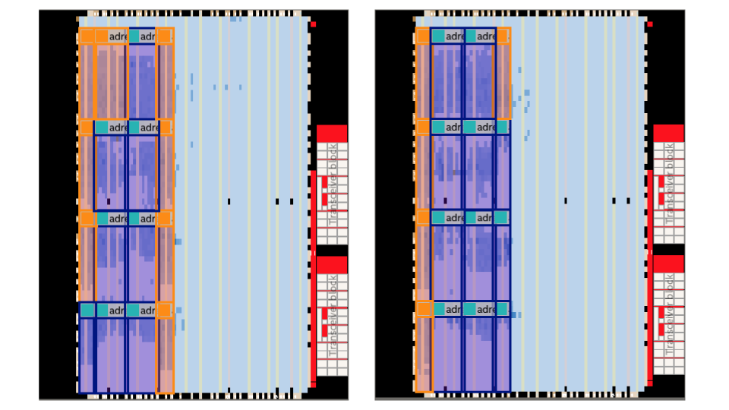
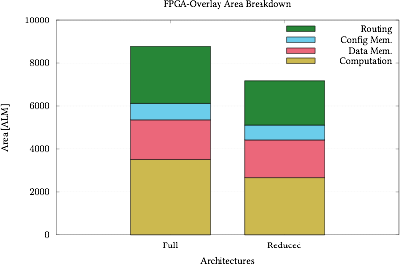
FPGA-Overlay CGRA (2)
Full
Reduced

Slide 44
Current and Future Work
Compact area, delay and power models
Create models for the frequently occurring CGRA components: MUXes, register file, config, functional units.
Permit quick estimates of CGRA power, performance, area, without a full standard-cell or FPGA-overlay synthesis
Improving standard-cell and FPGA overlay physical realizations
Multiple context support
Integration with a processor simulator such as Gem5

Slide 45
Summary
Standard-cell coarse-grained reconfigurable arrays (CGRAs) aim to provide (some of) the programmability of FPGAs with the speed/area/power of custom ASICs
FPGA-overlay CGRAs aim to provide faster programmability with software speed compile times
Many CGRAs proposed in academia/industry
No framework to scientifically evaluate/compare
CGRA-ME provides a platform for CGRA architecture and CAD research

Slide 46
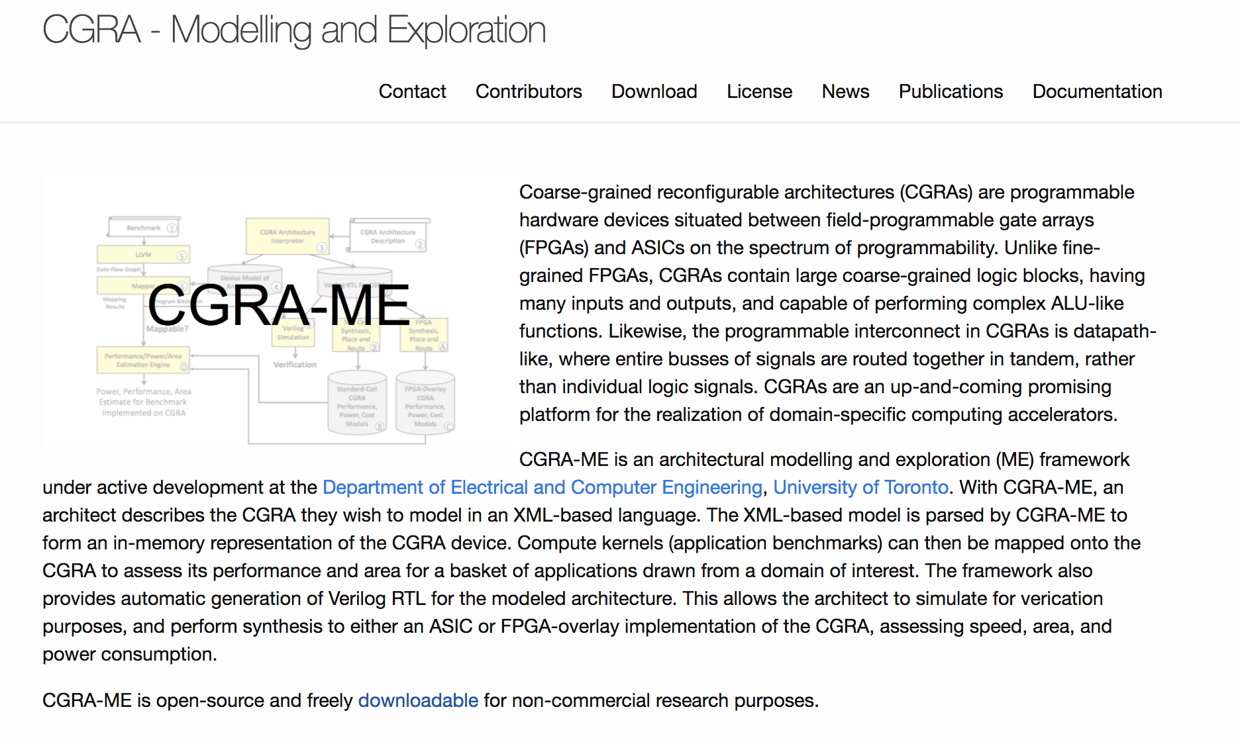

Follow the Project: http://cgra-me.ece.utoronto.ca

